Slide 1

Confidently Engaging Visitors at the Sanctuary
Volunteer Training — Hawk's Rest Bird Sanctuary
24th April 2026
Training facilitator: Alan Henks
Training moderator: Sally Hume

Slide 2

Introductions
Please type your name and favourite bird in the chat!

Slide 3

Guidelines
Mute when not speaking
Use the chat for questions and comments
Please participate actively in polls and discussions!
If you are having technical issues, please contact our moderator, Sally
The recording will be available after the session

Slide 4
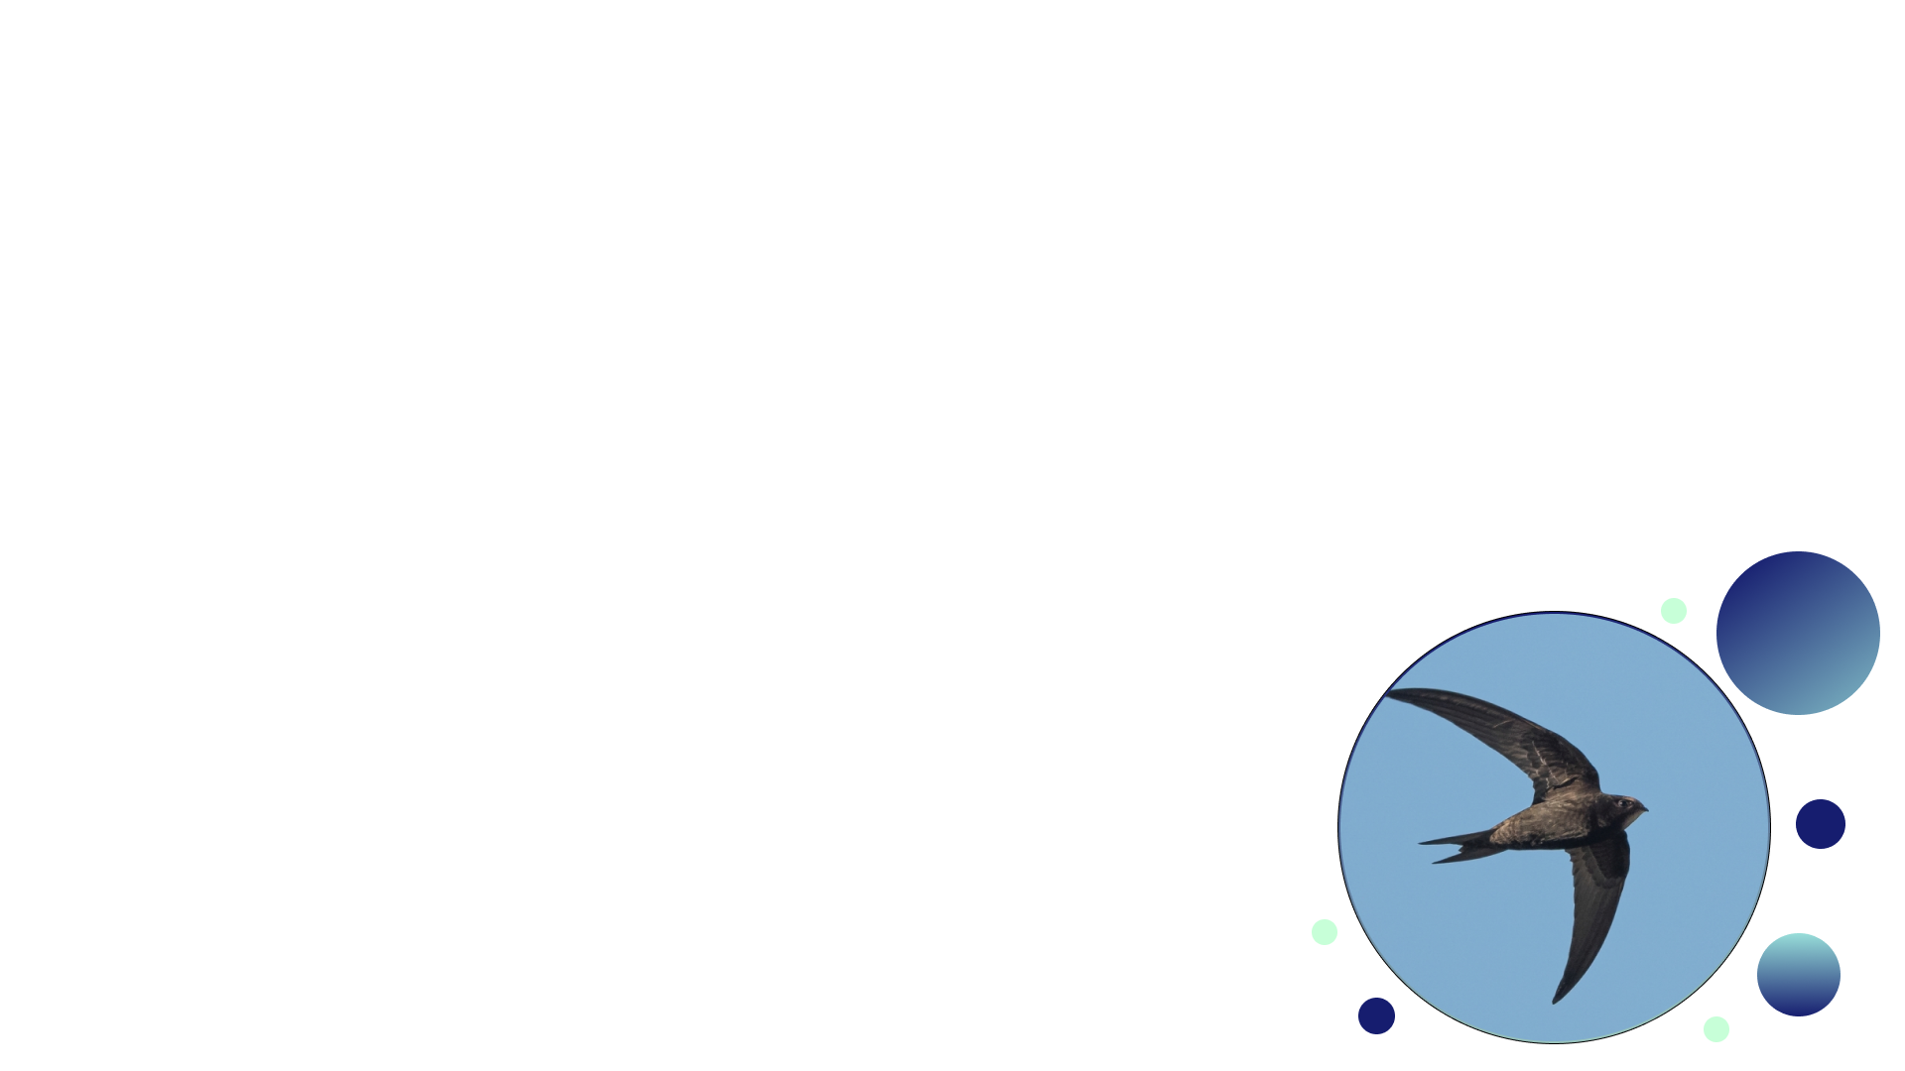
What we're covering today
Delivering sanctuary messages clearly: 20 minutes
Speaking with clarity and confidence: 20 minutes
Responding in real time: 15 minutes
Behaviour management strategies: 5 minutes

Slide 5
Learning Objectives
Apply strategies to manage visitor behaviour
Demonstrate clear and engaging speaking techniques
Respond appropriately to challenging questions/behaviour
Deliver key sanctuary messages accurately and consistently

Slide 6


"Have you ever spoken to a large group in an official capacity?"

Slide 7

DELIVERING SANCTUARY MESSAGES CLEARLY AND CONSISTENTLY
Topic 1:

Slide 8
Why Consistency Matters
Unclear and Inconsistent
Clear and Consistent
Visitor confusion
Complaints
Reputational risk
Informed visitor
Enhanced reputation
Confident volunteer
Trust in the charity

Slide 9


Core Sanctuary Messages
Our mission:
To rescue, treat and release birds wherever possible, and to house those for whom release is not possible.
How donations are used:
1. Keeping the sanctuary open
2. Research
3. Treatment of injured birds
*We are not for profit*
Rehabilitation Process (SOARS):
S: Secure (rescue & treatment)
O: Observation (stabilisation & first aid)
A: Administer care (treatment)
R: Restore (Recuperation & rehabilitation)
S: Set free (release)
Key Species:
Vultures
Swans
Kites
Gulls

Slide 10



Don't | Do
We fix hurt birds. | We care for injured and orphaned birds, nurse them back to health, and release them back into the wild whenever we can.
I'm not totally sure, but I think it does that because it's stressed. | This behaviour usually means she's alert and focused – birds of prey are incredibly tuned in to their surroundings
I don't know, that's not really my area. | That's a great question — let me find out the answer for you and come back to you before the end of the tour.
Tone & Consistency
Expectations

Slide 11

Think about a time you had a great experience as a visitor somewhere. What made it memorable?

Slide 12

Topic 2:
SPEAKING WITH CLARITY AND CONFIDENCE

Slide 13




Voice Clarity & Pacing
PROJECTION
Speak to the back of the group.
PACING
Slow down your speech
AVOID FILLERS
These can distract & undermine

Slide 14

Structuring Explanations
HOOK
CORE
CLOSE
Grab listeners' attention with a surprising fact or question
Land the message you want the audience to take away
Deliver the key information simply & clearly
"Did you know a kestrel can spot a beetle from 50 metres away? They can even see ultraviolet light, which lets them track mice from high in the air."
"Kestrels are one of the species we care for here. Most come to us after collisions with vehicles or windows. We rehabilitate them and, where possible, release them back into the wild."
"Every bird we successfully release is back where it belongs. That's what this sanctuary is for — and what your support makes possible."

Slide 15



Adjusting to Different Audiences
Short sentences
Questions
Analogies
What is a word or phrase that we might use with adult visitors which might not be appropriate when showing younger people the centre?
Detail
Wider themes
Hook to engage
Detail layered into answer

Slide 16


Breakout Rooms
What does the sanctuary do?
Speaker:
Deliver a 1 minute explanation to:
An adult.
A child.
Partner:
Give feedback.
One thing which you did well...
One thing you could try and change...

Slide 17
Breakout Rooms
What felt natural?
What felt harder than expected?

Slide 18

Topic 3
RESPONDING APPROPRIATELY IN REAL TIME

Slide 19

Why do you keep birds in captivity? Isn't that cruel?
A: Agree that it's a complicated issue.
B: Explain the rehabilitation mission and release programme.
C: Say you're not sure and offer to get a supervisor.
D: Change the subject

Slide 20


Answering Difficult Questions: AABB Framework
Acknowledge
Answer
Bridge Back
Shows respect and gains thinking time.
That's a really important question...
That's a very thoughtful question...
I appreciate you bringing that up...
Use approved messaging or offer to ask and get back to the questioner later in the tour.
Return confidently to the tour structure, don't allow the flow to be impacted by repeated questions.

Slide 21
Breakout Rooms
Role-Play
In pairs, you will be given a scenario card.
Use the AABB framework to help you navigate the challenging scenario.

Slide 22
Breakout Rooms
Which scenario was the most challenging?
Did the AABB framework help you?

Slide 23

Topic 4
BEHAVIOUR MANAGEMENT STRATEGIES

Slide 24
Setting Expectations Early.
Use a brief, friendly introduction.
Think about your positioning.
Outline what visitors can/can't do.
Demonstrate confidence with your posture.

Slide 25
Posture
Hands in pockets
Standing up straight
Fast movements
Making eye contact
Speaking quickly

Slide 26



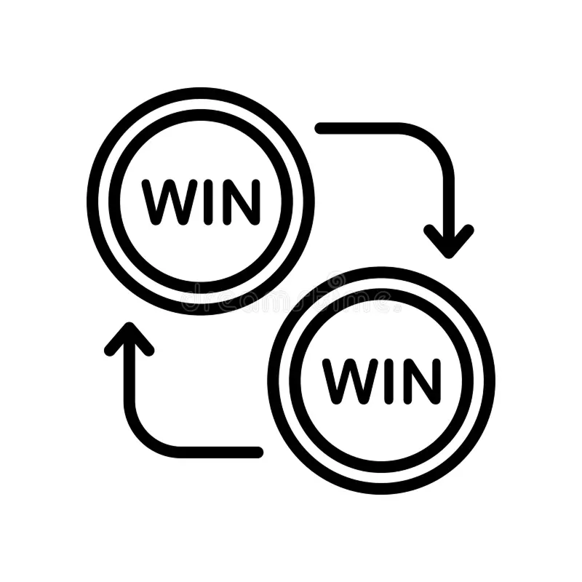
Calm Boundary-Setting
Friendly but firm
Be proactive & consistent
De-Escalation
Lower your voice – don't raise it!
Acknowledge frustration
Look for win/win solutions

Slide 27
Knowledge Check

Slide 28


A: SOARS
B: How donations are used
Which of these is NOT a core sanctuary message?
C: Key species
D: How visitors can volunteer

Slide 29

A: A question
B: The key message
What does the "Hook-Core-Close" framework start with (Choose all which apply)?
C: Important detail
D: An interesting fact

Slide 30

What is the first step when a visitor asks a tricky question?
A: Answer quickly and move on
B: Acknowledge the question
C: Get a supervisor to help
D: Tell them you only accept questions at the end of the tour

Slide 31

When is the best time to set visitor expectations?
A: Before the tour date in the preparatory correspondence.
B: As issues arise so as not to waste time.
C: During the tour introduction.
D: There are no set expectations as every tour is different.

Slide 32
What is one thing you will utilise from today's session in future tours?

Slide 33
Questions?
Please add any questions you have about today's session in the chat!

Slide 34
Next Steps
Review the session key content
Create your own 'hook'
Shadow a more experienced guide

Slide 35
Thank-you!

